Slide 1
Transport Layer
Dr. Tulika

Slide 2
Outline
transport-layer services
multiplexing and demultiplexing
connectionless transport: UDP
principles of reliable data transfer
connection-oriented transport: TCP
  segment structure
  reliable data transfer
  flow control
  connection management
principles of congestion control
TCP congestion control

Slide 3

















Transport services and protocols
application
transport
network
data link
physical
provide logical communication between app processes running on different hosts
transport protocols run in end systems
  send side: breaks app messages into segments, passes to network layer
  rcv side: reassembles segments into messages, passes to app layer
more than one transport protocol available to apps
  Internet: TCP and UDP
logical end-end transport
application
transport
network
data link
physical

Slide 4
Transport vs. network layer
network layer: logical communication between hosts
transport layer: logical communication between processes
  relies on, enhances, network layer services
household analogy:
12 kids in Ann’s house sending letters to 12 kids in Bill’s house:
hosts = houses
processes = kids
app messages = letters in envelopes
transport protocol = Ann and Bill who demux to in-house siblings
network-layer protocol = postal service

Slide 5
Port Number
Transport layer address
Used to choose among multiple processes running on the destination host.
Destination port number is needed for delivery and the source port number is needed for the reply
16 bits integer number between 0 to 65535

Slide 6
Port Number Ranges
IANA (Internet Assigned Number Authority) divided port number into three ranges
Well known ports
  0-1023
  Assigned and controlled by IANA
Registered Ports
  1024-49151
  Not assigned and controlled by IANA. They can be registered with IANA to prevent duplication.
Dynamic Ports
  49152-65535
  Neither controlled nor registered. They can be used by any process.

Slide 7
Internet transport-layer protocols
reliable, in-order delivery (TCP)
  congestion control
  flow control
  connection setup
unreliable, unordered delivery: UDP
services not available:
  delay guarantees
  bandwidth guarantees
application
transport
network
data link
physical
network
data link
physical
network
data link
physical
network
data link
physical
logical end-end transport
network
data link
physical
network
data link
physical
network
data link
physical
network
data link
physical
application
transport
network
data link
physical

Slide 8

Multiplexing/demultiplexing
multiplexing at sender:
handle data from multiple
sockets, add transport header (later used for demultiplexing)
demultiplexing at receiver:
use header info to deliver
received segments to correct
socket
application
application
P1
P2
application
socket
P3
transport
P4
process
transport
network
transport
network
link
network
link
physical
link
physical
physical

Slide 9
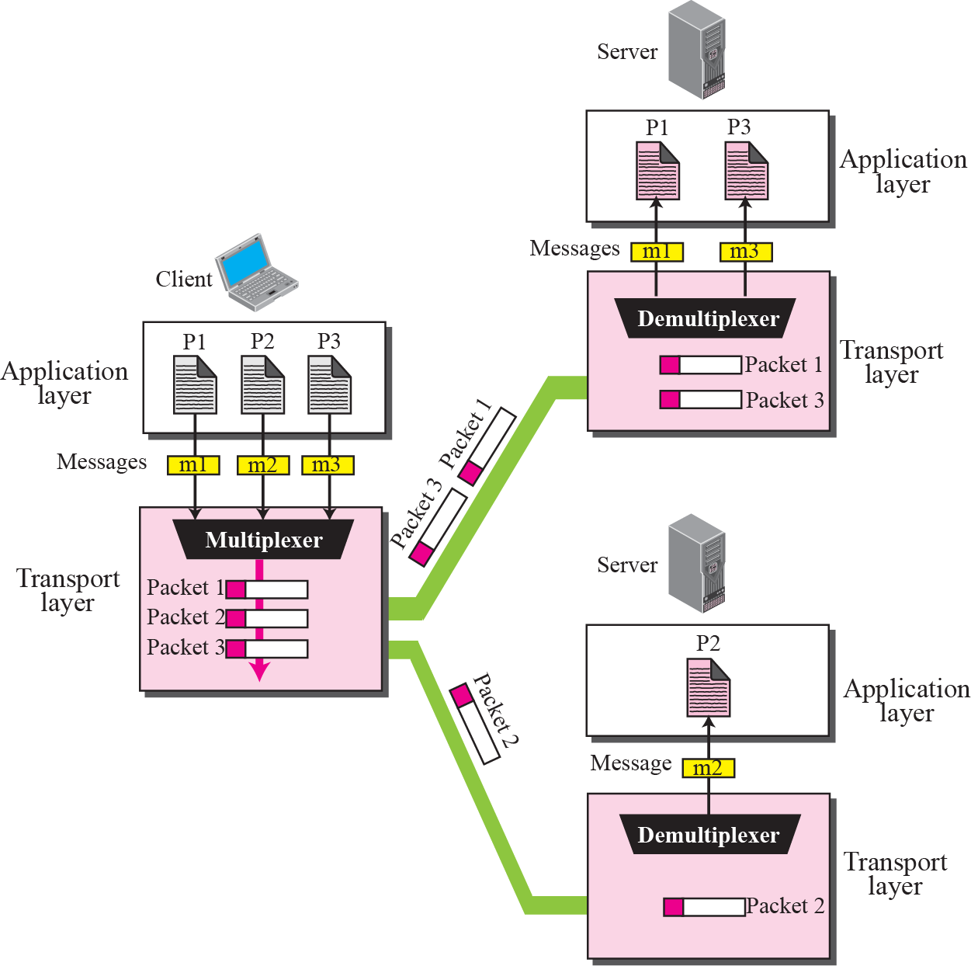
Multiplexing/demultiplexing

Slide 10
UDP: User Datagram Protocol
Simple transport protocol
“best effort” service, UDP segments may be:
  lost
  delivered out-of-order to app
connectionless:
  no handshaking between UDP sender, receiver
  each UDP segment handled independently of others
UDP use:
  streaming multimedia apps (loss tolerant, rate sensitive)
  DNS
  SNMP
reliable transfer over UDP:
  add reliability at application layer
  application-specific error recovery!

Slide 11
UDP: segment header
length, in bytes of UDP segment, including header
32 bits
source port #
dest port #
length
checksum
why is there a UDP?
no connection establishment (which can add delay)
simple: no connection state at sender, receiver
small header size
no congestion control: UDP can blast away as fast as desired
application
data
(payload)
UDP segment format

Slide 12
UDP checksum
Goal: detect “errors” (e.g., flipped bits) in transmitted segment
sender:
treat segment contents, including header fields, as sequence of 16-bit integers
checksum: addition (one’s complement sum) of segment contents
sender puts checksum value into UDP checksum field
receiver:
compute checksum of received segment
check if computed checksum equals checksum field value:
  NO - error detected
  YES - no error detected. But maybe errors nonetheless? More later ….

Slide 13
Internet checksum: example
example: add two 16-bit integers
1 1 1 1 0 0 1 1 0 0 1 1 0 0 1 1 0
1 1 1 0 1 0 1 0 1 0 1 0 1 0 1 0 1
1 1 0 1 1 1 0 1 1 1 0 1 1 1 0 1 1
1 1 0 1 1 1 0 1 1 1 0 1 1 1 1 0 0
1 0 1 0 0 0 1 0 0 0 1 0 0 0 0 1 1
wraparound
sum
checksum
Note: when adding numbers, a carryout from the most significant bit needs to be added to the result
Notes:
Kurose and Ross forgot to say anything about wrapping the carry and adding it to low order bit

Slide 14
Transmission Control Protocol (TCP)
TCP is a connection-oriented protocol
  It creates a virtual connection between two TCPs to send data.
TCP uses flow and error control mechanism at the transport level.
reliable, in-order byte steam
Congestion Control

Slide 15
TCP Segment
The bytes of data being transferred in each connection are numbered by TCP. The numbering starts with a randomly generated number.
The value in the sequence number field of a segment defines the number of the first data byte contained in that segment.
The value of the acknowledgment field in a segment defines the number of the next byte a party expects to receive.
The acknowledgment number is cumulative.

Slide 16
TCP segment
The following shows the sequence number for each segment: (Each segment is of 1000 bytes.
Segment 1 ---Sequence Number: 10001 (range:10001 to 11000)
Segment 2 ---Sequence Number: 11001 (range:11001 to 12000)
Segment 3 ---Sequence Number: 12001 (range:12001 to 13000)
Segment 4 ---Sequence Number: 13001 (range:13001 to 14000)
Segment 5 ---Sequence Number: 14001 (range:14001 to 15000)

Slide 17
TCP segment structure
32 bits
URG: urgent data
(generally not used)
counting
by bytes
of data
(not segments!)
source port #
dest port #
sequence number
ACK: ACK #
valid
acknowledgement number
head
len
not
used
U
receive window
A
PSH: push data now
(generally not used)
P
R
S
F
# bytes
rcvr willing
to accept
checksum
Urg data pointer
RST, SYN, FIN:
connection estab
(setup, teardown
commands)
options (variable length)
application
data
(variable length)
Internet
checksum
(as in UDP)

Slide 18
TCP seq. numbers, ACKs
outgoing segment from sender
sequence numbers:
  byte stream “number” of first byte in segment’s data
acknowledgements:
  seq # of next byte expected from other side
  cumulative ACK
Q: how receiver handles out-of-order segments
  A: TCP spec doesn’t say, - up to implementer
source port #
dest port #
sequence number
acknowledgement number
rwnd
checksum
urg pointer
window size
N
  sender sequence number space
sent
ACKed
sent, not-yet ACKed
(“in-flight”)
usable
but not
yet sent
not
usable
incoming segment to sender
source port #
dest port #
sequence number
acknowledgement number
A
rwnd
checksum
urg pointer

Slide 19
TCP seq. numbers, ACKs
Host A
Host B
User
types
‘C’
Seq=42, ACK=79, data = ‘C’
host ACKs
receipt of
‘C’, echoes
back ‘C’
Seq=79, ACK=43, data = ‘C’
host ACKs
receipt
of echoed
‘C’
Seq=43, ACK=80
simple telnet scenario

Slide 20
TCP round trip time, timeout
Q: how to set TCP timeout value?
longer than RTT
  but RTT varies
too short: premature timeout, unnecessary retransmissions
too long: slow reaction to segment loss
Q: how to estimate RTT?
SampleRTT: measured time from segment transmission until ACK receipt
  ignore retransmissions
SampleRTT will vary, want estimated RTT “smoother”
  average several recent measurements, not just current SampleRTT

Slide 21
TCP round trip time, timeout
EstimatedRTT = (1- α)*EstimatedRTT + α*SampleRTT
exponential weighted moving average
influence of past sample decreases exponentially fast
typical value: α = 0.125
RTT: gaia.cs.umass.edu to fantasia.eurecom.fr
RTT (milliseconds)
sampleRTT
EstimatedRTT
time (seconds)

Slide 22

TCP round trip time, timeout
timeout interval: EstimatedRTT plus “safety margin”
  large variation in EstimatedRTT -> larger safety margin
estimate SampleRTT deviation from EstimatedRTT:
DevRTT = (1-β)*DevRTT +
β*|SampleRTT-EstimatedRTT|
(typically, β = 0.25)
TimeoutInterval = EstimatedRTT + 4*DevRTT
estimated RTT
“safety margin”

Slide 23
Chapter 3 outline
3.5 connection-oriented transport: TCP
  segment structure
  reliable data transfer
  flow control
  connection management
3.6 principles of congestion control
3.7 TCP congestion control
3.1 transport-layer services
3.2 multiplexing and demultiplexing
3.3 connectionless transport: UDP
3.4 principles of reliable data transfer

Slide 24
TCP reliable data transfer
TCP creates rdt service on top of IP’s unreliable service
  pipelined segments
  cumulative acks
  single retransmission timer
retransmissions triggered by:
  timeout events
  duplicate acks
let’s initially consider simplified TCP sender:
  ignore duplicate acks
  ignore flow control, congestion control

Slide 25
TCP sender events:
data rcvd from app:
create segment with seq #
seq # is byte-stream number of first data byte in segment
start timer if not already running
  think of timer as for oldest unacked segment
  expiration interval: TimeOutInterval
timeout:
retransmit segment that caused timeout
restart timer
ack rcvd:
if ack acknowledges previously unacked segments
  update what is known to be ACKed
  start timer if there are still unacked segments

Slide 26
TCP sender (simplified)
data received from application above
create segment, seq. #: NextSeqNum
pass segment to IP (i.e., “send”)
NextSeqNum = NextSeqNum + length(data)
if (timer currently not running)
start timer
Λ
NextSeqNum = InitialSeqNum
SendBase = InitialSeqNum
wait
for
event
timeout
retransmit not-yet-acked segment with smallest seq. #
start timer
ACK received, with ACK field value y
if (y > SendBase) {
SendBase = y
/* SendBase–1: last cumulatively ACKed byte */
if (there are currently not-yet-acked segments)
start timer
else stop timer
}

Slide 27
TCP: retransmission scenarios
Host A
Host B
Host A
Host B
SendBase=92
Seq=92, 8 bytes of data
Seq=92, 8 bytes of data
timeout
timeout
Seq=100, 20 bytes of data
ACK=100
X
ACK=100
ACK=120
Seq=92, 8 bytes of data
Seq=92, 8
bytes of data
SendBase=100
SendBase=120
ACK=100
ACK=120
SendBase=120
lost ACK scenario
premature timeout

Slide 28
TCP: retransmission scenarios
Host A
Host B
Seq=92, 8 bytes of data
Seq=100, 20 bytes of data
timeout
ACK=100
X
ACK=120
Seq=120, 15 bytes of data
cumulative ACK

Slide 29
TCP ACK generation [RFC 1122, RFC 2581]
event at receiver
arrival of in-order segment with
expected seq #. All data up to
expected seq # already ACKed
arrival of in-order segment with
expected seq #. One other
segment has ACK pending
arrival of out-of-order segment
higher-than-expect seq. # .
Gap detected
arrival of segment that
partially or completely fills gap
TCP receiver action
delayed ACK. Wait up to 500ms
for next segment. If no next segment,
send ACK
immediately send single cumulative
ACK, ACKing both in-order segments
immediately send duplicate ACK,
indicating seq. # of next expected byte
immediate send ACK, provided that
segment starts at lower end of gap

Slide 30
TCP fast retransmit
time-out period often relatively long:
  long delay before resending lost packet
detect lost segments via duplicate ACKs.
  sender often sends many segments back-to-back
  if segment is lost, there will likely be many duplicate ACKs.
TCP fast retransmit
if sender receives 3 ACKs for same data
(“triple duplicate ACKs”), resend unacked segment with smallest seq #
  likely that unacked segment lost, so don’t wait for timeout
(“triple duplicate ACKs”),

Slide 31
TCP fast retransmit
Host A
Host B
Seq=92, 8 bytes of data
Seq=100, 20 bytes of data
X
ACK=100
timeout
ACK=100
ACK=100
ACK=100
Seq=100, 20 bytes of data
fast retransmit after sender
receipt of triple duplicate ACK

Slide 32
Chapter 3 outline
3.5 connection-oriented transport: TCP
  segment structure
  reliable data transfer
  flow control
  connection management
3.6 principles of congestion control
3.7 TCP congestion control
3.1 transport-layer services
3.2 multiplexing and demultiplexing
3.3 connectionless transport: UDP
3.4 principles of reliable data transfer

Slide 33
TCP flow control
application
process
Application
removes data from
TCP socket buffers ….
application
TCP socket
receiver buffers
OS
receiver is delivering
(sender is sending)
TCP
code
flow control
IP
code
receiver controls sender, so sender won’t overflow receiver’s buffer by transmitting too much, too fast
from sender
receiver protocol stack

Slide 34
TCP flow control
receiver “advertises” free buffer space by including rwnd value in TCP header of receiver-to-sender segments
  RcvBuffer size set via socket options (typical default is 4096 bytes)
  many operating systems autoadjust RcvBuffer
sender limits amount of unacked (“in-flight”) data to receiver’s rwnd value
guarantees receive buffer will not overflow
to application process
RcvBuffer
buffered data
rwnd
free buffer space
TCP segment payloads
receiver-side buffering

Slide 35
Chapter 3 outline
3.5 connection-oriented transport: TCP
  segment structure
  reliable data transfer
  flow control
  connection management
3.6 principles of congestion control
3.7 TCP congestion control
3.1 transport-layer services
3.2 multiplexing and demultiplexing
3.3 connectionless transport: UDP
3.4 principles of reliable data transfer

Slide 36
Connection Management
before exchanging data, sender/receiver “handshake”:
agree to establish connection (each knowing the other willing to establish connection)
agree on connection parameters
application
application
connection state: ESTAB
connection variables:
  seq # client-to-server
  server-to-client
  rcvBuffer size
  at server,client
connection state: ESTAB
connection Variables:
  seq # client-to-server
  server-to-client
  rcvBuffer size
  at server,client
network
network
Socket clientSocket =
newSocket("hostname","port number");
Socket connectionSocket = welcomeSocket.accept();

Slide 37



Agreeing to establish a connection
2-way handshake:
Q: will 2-way handshake always work in network?
variable delays
retransmitted messages (e.g. req_conn(x)) due to message loss
message reordering
can’t “see” other side
Let’s talk
ESTAB
OK
ESTAB
choose x
req_conn(x)
ESTAB
acc_conn(x)
ESTAB

Slide 38
Agreeing to establish a connection
2-way handshake failure scenarios:
choose x
choose x
req_conn(x)
req_conn(x)
ESTAB
ESTAB
retransmit
req_conn(x)
acc_conn(x)
retransmit
req_conn(x)
acc_conn(x)
ESTAB
ESTAB
data(x+1)
accept
data(x+1)
req_conn(x)
retransmit
data(x+1)
connection
x completes
connection
x completes
client terminates
server
forgets x
client terminates
server
forgets x
req_conn(x)
ESTAB
data(x+1)
ESTAB
half open connection!
(no client!)
accept
data(x+1)

Slide 39
TCP 3-way handshake
client state
server state
LISTEN
LISTEN
choose init seq num, x
send TCP SYN msg
SYNSENT
SYNbit=1, Seq=x
choose init seq num, y
send TCP SYNACK
msg, acking SYN
SYN RCVD
SYNbit=1, Seq=y
ACKbit=1; ACKnum=x+1
received SYNACK(x)
indicates server is live;
send ACK for SYNACK;
this segment may contain
client-to-server data
ESTAB
ACKbit=1, ACKnum=y+1
received ACK(y)
indicates client is live
ESTAB

Slide 40
TCP 3-way handshake: FSM
closed
Socket connectionSocket = welcomeSocket.accept();
Λ
Socket clientSocket =
newSocket("hostname","port number");
SYN(x)
SYNACK(seq=y,ACKnum=x+1)
create new socket for
communication back to client
listen
SYN(seq=x)
SYN
rcvd
SYN
sent
SYNACK(seq=y,ACKnum=x+1)
ACK(ACKnum=y+1)
ESTAB
ACK(ACKnum=y+1)
Λ

Slide 41
TCP: closing a connection
client, server each close their side of connection
  send TCP segment with FIN bit = 1
respond to received FIN with ACK
  on receiving FIN, ACK can be combined with own FIN
simultaneous FIN exchanges can be handled

Slide 42
TCP: closing a connection
client state
server state
ESTAB
ESTAB
clientSocket.close()
FIN_WAIT_1
can no longer
send but can
receive data
FINbit=1, seq=x
CLOSE_WAIT
ACKbit=1; ACKnum=x+1
can still
send data
FIN_WAIT_2
wait for server
close
LAST_ACK
FINbit=1, seq=y
TIMED_WAIT
can no longer
send data
ACKbit=1; ACKnum=y+1
timed wait
for 2*max
segment lifetime
CLOSED
CLOSED

Slide 43
Chapter 3 outline
3.5 connection-oriented transport: TCP
  segment structure
  reliable data transfer
  flow control
  connection management
3.6 principles of congestion control
3.7 TCP congestion control
3.1 transport-layer services
3.2 multiplexing and demultiplexing
3.3 connectionless transport: UDP
3.4 principles of reliable data transfer

Slide 44
Principles of congestion control
congestion:
informally: “too many sources sending too much data too fast for network to handle”
different from flow control!
manifestations:
  lost packets (buffer overflow at routers)
  long delays (queueing in router buffers)
a top-10 problem!

Slide 45

Causes/costs of congestion: scenario 1
original data: λ_{in}
throughput: λ_{out}
two senders, two receivers
one router, infinite buffers
output link capacity: R
no retransmission
Host A
unlimited shared output link buffers
Host B
R/2
λ_{out}
delay
λ_{in}
R/2
λ_{in}
R/2
maximum per-connection throughput: R/2
large delays as arrival rate, λ_{in}, approaches capacity

Slide 46
Causes/costs of congestion: scenario 2
one router, finite buffers
sender retransmission of timed-out packet
  application-layer input = application-layer output: λ_{in} = λ_{out}
  transport-layer input includes retransmissions : λ_{in} λ_{in}
‘
λ_{in} : original data
λ'_{in}: original data, plus retransmitted data
λ_{out}
Host A
finite shared output link buffers
Host B

Slide 47
Causes/costs of congestion: scenario 2
R/2
idealization: perfect knowledge
sender sends only when router buffers available
λ_{out}
λ_{in}
R/2
λ_{in} : original data
copy
λ'_{in}: original data, plus retransmitted data
λ_{out}
A
free buffer space!
finite shared output link buffers
Host B

Slide 48
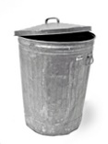
Causes/costs of congestion: scenario 2
Idealization: known loss packets can be lost, dropped at router due to full buffers
sender only resends if packet known to be lost
λ_{in} : original data
copy
λ'_{in}: original data, plus retransmitted data
λ_{out}
A
no buffer space!
Host B

Slide 49
Causes/costs of congestion: scenario 2
Idealization: known loss packets can be lost, dropped at router due to full buffers
sender only resends if packet known to be lost
R/2
when sending at R/2, some packets are retransmissions but asymptotic goodput is still R/2 (why?)
λ_{out}
λ_{in}
R/2
λ_{in} : original data
λ'_{in}: original data, plus retransmitted data
λ_{out}
A
free buffer space!
Host B

Slide 50


Causes/costs of congestion: scenario 2
Realistic: duplicates
packets can be lost, dropped at router due to full buffers
sender times out prematurely, sending two copies, both of which are delivered
R/2
when sending at R/2, some packets are retransmissions including duplicated that are delivered!
λ_{out}
λ_{in}
R/2
λ_{in}
copy
λ'_{in}
λ_{out}
timeout
A
free buffer space!
Host B

Slide 51
Causes/costs of congestion: scenario 2
Realistic: duplicates
packets can be lost, dropped at router due to full buffers
sender times out prematurely, sending two copies, both of which are delivered
R/2
when sending at R/2, some packets are retransmissions including duplicated that are delivered!
λ_{out}
λ_{in}
R/2
“costs” of congestion:
more work (retrans) for given “goodput”
unneeded retransmissions: link carries multiple copies of pkt
  decreasing goodput

Slide 52
Causes/costs of congestion: scenario 3
Q: what happens as λ_{in} and λ_{in}’ increase ?
four senders
multihop paths
timeout/retransmit
A: as red λ_{in}’ increases, all arriving blue pkts at upper queue are dropped, blue throughput g 0
Host A
λ_{in} : original data
λ_{out}
Host B
λ'_{in}: original data, plus retransmitted data
finite shared output link buffers
Host D
Host C

Slide 53
Causes/costs of congestion: scenario 3
C/2
λ_{out}
λ_{in}’
C/2
another “cost” of congestion:
when packet dropped, any “upstream transmission capacity used for that packet was wasted!

Slide 54
Approaches towards congestion control
two broad approaches towards congestion control:
end-end congestion control:
no explicit feedback from network
congestion inferred from end-system observed loss, delay
approach taken by TCP
network-assisted congestion control:
routers/switches provide feedback to end systems
  single bit indicating congestion (SNA, DECbit, TCP/IP ECN, ATM)
  explicit rate for sender to send at

Slide 55
Case study: ATM ABR congestion control
ABR: available bit rate:
“elastic service”
if sender’s path “underloaded”:
  sender should use available bandwidth
if sender’s path congested:
  sender throttled to minimum guaranteed rate
RM (resource management) cells:
sent by sender, interspersed with data cells (1 RM-32 data)
bits in RM cell set by switches (“network-assisted”)
  NI bit: no increase in rate (mild congestion)
  CI bit: congestion indication
RM cells returned to sender by receiver, with bits intact

Slide 56
Case study: ATM ABR congestion control
RM cell
data cell
two-byte ER (explicit rate) field in RM cell
  congested switch may lower ER value in cell
  senders’ send rate thus max supportable rate on path
EFCI (Explicit Forward CI) bit in data cells: set to 1 in congested switch
  if data cell preceding RM cell has EFCI set, receiver sets CI bit in returned RM cell

Slide 57
Chapter 3 outline
3.5 connection-oriented transport: TCP
  segment structure
  reliable data transfer
  flow control
  connection management
3.6 principles of congestion control
3.7 TCP congestion control
3.1 transport-layer services
3.2 multiplexing and demultiplexing
3.3 connectionless transport: UDP
3.4 principles of reliable data transfer

Slide 58
TCP congestion control: additive increase multiplicative decrease
approach: sender increases transmission rate (window size), probing for usable bandwidth, until loss occurs
  additive increase: increase cwnd by 1 MSS every RTT until loss detected
  multiplicative decrease: cut cwnd in half after loss
additively increase window size …
…. until loss occurs (then cut window in half)
AIMD saw tooth
behavior: probing
for bandwidth
cwnd: TCP sender
congestion window size
time

Slide 59
TCP Congestion Control: details
sender sequence number space
TCP sending rate:
roughly: send cwnd bytes, wait RTT for ACKS, then send more bytes
cwnd
last byte
ACKed
last byte sent
sent, not-yet ACKed
(“in-flight”)
rate
cwnd
sender limits transmission:
cwnd is dynamic, function of perceived network congestion
~
bytes/sec
~
RTT
LastByteSent-
LastByteAcked
cwnd
<

Slide 60
TCP Slow Start
Host A
Host B
when connection begins, increase rate exponentially until first loss event:
  initially cwnd = 1 MSS
  double cwnd every RTT
  done by incrementing cwnd for every ACK received
summary: initial rate is slow but ramps up exponentially fast
one segment
RTT
two segments
four segments
time

Slide 61
TCP: detecting, reacting to loss
loss indicated by timeout:
  cwnd set to 1 MSS;
  window then grows exponentially (as in slow start) to threshold, then grows linearly
loss indicated by 3 duplicate ACKs: TCP RENO
  dup ACKs indicate network capable of delivering some segments
  cwnd is cut in half window then grows linearly
TCP Tahoe always sets cwnd to 1 (timeout or 3 duplicate acks)

Slide 62

TCP: switching from slow start to CA
Q: when should the exponential increase switch to linear?
A: when cwnd gets to 1/2 of its value before timeout.
Implementation:
variable ssthresh
on loss event, ssthresh is set to 1/2 of cwnd just before loss event

Slide 63

Summary: TCP Congestion Control
New
ACK!
New
ACK!
.
duplicate ACK
new ACK
dupACKcount++
new ACK
cwnd = cwnd + MSS (MSS/cwnd)
dupACKcount = 0
transmit new segment(s), as allowed
cwnd = cwnd+MSS
dupACKcount = 0
transmit new segment(s), as allowed
Λ
cwnd = 1 MSS
ssthresh = 64 KB
dupACKcount = 0
cwnd > ssthresh
slow
start
Λ
congestion
avoidance
timeout
ssthresh = cwnd/2
cwnd = 1 MSS
dupACKcount = 0
retransmit missing segment
duplicate ACK
timeout
dupACKcount++
ssthresh = cwnd/2
cwnd = 1 MSS
dupACKcount = 0
retransmit missing segment
timeout
New
ACK!
ssthresh = cwnd/2
cwnd = 1 MSS
dupACKcount = 0
retransmit missing segment
New ACK
dupACKcount == 3
cwnd = ssthresh
dupACKcount = 0
dupACKcount == 3
ssthresh= cwnd/2
cwnd = ssthresh + 3 MSS
retransmit missing segment
ssthresh= cwnd/2
cwnd = ssthresh + 3 MSS
retransmit missing segment
fast
recovery
duplicate ACK
cwnd = cwnd + MSS
transmit new segment(s), as allowed

Slide 64
TCP throughput
avg. TCP thruput as function of window size, RTT?
  ignore slow start, assume always data to send
W: window size (measured in bytes) where loss occurs
  avg. window size (# in-flight bytes) is ¾ W
  avg. thruput is 3/4W per RTT
avg TCP thruput =
3
W
4
RTT
bytes/sec
W
W/2

Slide 65
TCP Futures: TCP over “long, fat pipes”
example: 1500 byte segments, 100ms RTT, want 10 Gbps throughput
requires W = 83,333 in-flight segments
throughput in terms of segment loss probability, L [Mathis 1997]:
  ➜ to achieve 10 Gbps throughput, need a loss rate of L = 2·10⁻¹⁰ – a very small loss rate!
new versions of TCP for high-speed
1.22
.
MSS
TCP throughput =
RTT
L

Slide 66
TCP Fairness
fairness goal: if K TCP sessions share same bottleneck link of bandwidth R, each should have average rate of R/K
TCP connection 1
bottleneck
router
capacity R
TCP connection 2

Slide 67
Why is TCP fair?
two competing sessions:
additive increase gives slope of 1, as throughout increases
multiplicative decrease decreases throughput proportionally
R
equal bandwidth share
loss: decrease window by factor of 2
congestion avoidance: additive increase
Connection 2 throughput
loss: decrease window by factor of 2
congestion avoidance: additive increase
Connection 1 throughput
R

Slide 68
Fairness (more)
Fairness and UDP
multimedia apps often do not use TCP
  do not want rate throttled by congestion control
instead use UDP:
  send audio/video at constant rate, tolerate packet loss
Fairness, parallel TCP connections
application can open multiple parallel connections between two hosts
web browsers do this
e.g., link of rate R with 9 existing connections:
  new app asks for 1 TCP, gets rate R/10
  new app asks for 11 TCPs, gets R/2

Slide 69
Chapter 3: summary
principles behind transport layer services:
  multiplexing, demultiplexing
  reliable data transfer
  flow control
  congestion control
instantiation, implementation in the Internet
  UDP
  TCP
next:
leaving the network “edge” (application, transport layers)
into the network “core”

